Slide 1

On-Campus Housing: Information Session

Slide 2
Purpose of This Session
2
Addressing Your Queries
We have been receiving numerous questions regarding on-campus housing, and this session is designed to address them comprehensively. And, we will further discuss any questions that you have during this meeting.

Slide 3






Main Topics to Be Covered
Meal Plans
Dorm Check-In
Understanding your dining options.
Your smooth arrival process.
On-Campus Life
Know Your Mailing Address
Exploring student activities.
Receiving your important mail while living on-campus.
Dorm Key Collection
Early Arrival Options
How to get your room keys.
Solutions for early arrivals.

Slide 4
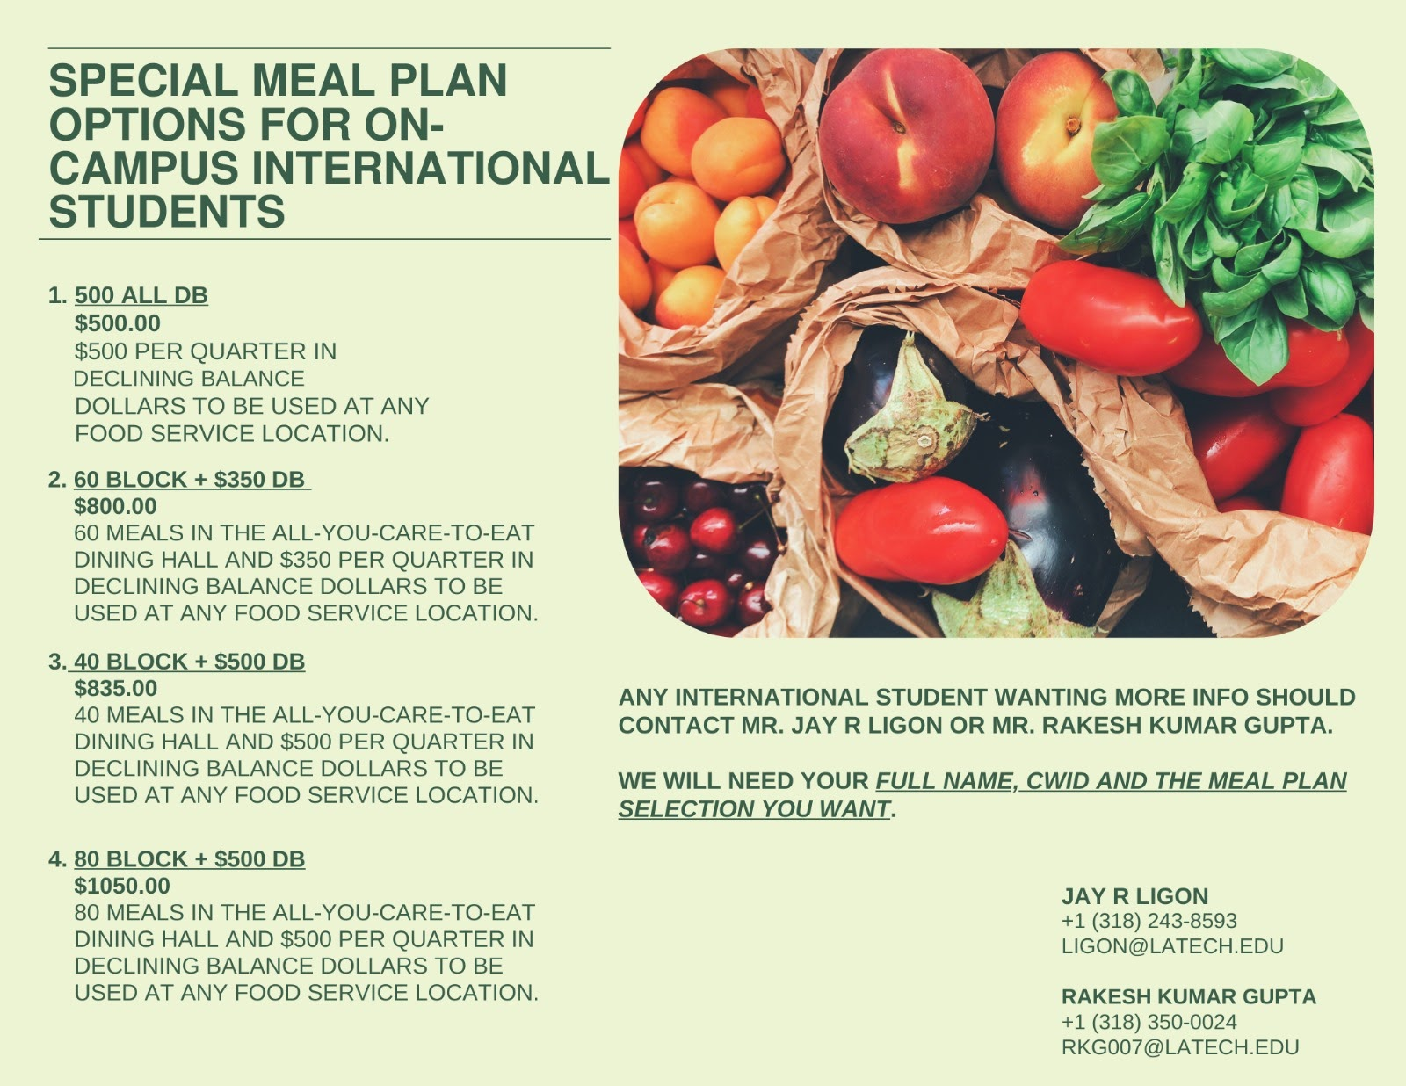
Meal Plan Overview
Understanding Your Options
Our meal plans offer flexibility and variety to suit every student's needs. Freshmen students who are going to live on-campus are automatically added to on-campus meal plan.
Meal plan options: https://latech.mydininghub.com/en/meal-plans/meal-plan-options
Special Meal Options For International Students
The Special Meal Plan is designed to provide international students with affordable and flexible meal choices that cater to their specific needs. These meal plans allow students to balance on-campus dining with the flexibility of cooking for themselves, making it a cost-effective option compared to the regular meal plan.
Google form link: https://forms.gle/4pKZCUBvmtuyZagn9

Slide 5
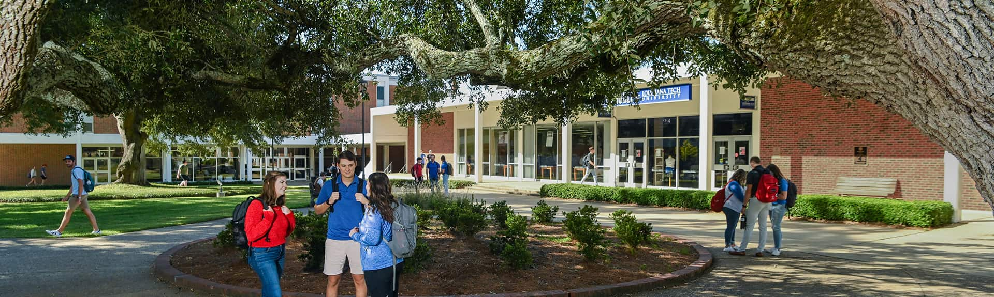
Dorm Check-In Process
01
02
Dorm Check-In
StarRez
Check-ins will begin at 9am on Monday, December 1st, 2025. Go to Wyly Tower 227 to pick up your key. And, you will get your dorm key, too.
Login to your StarRez account to see which room has been assigned to you.
03
Special Permission
If you have any special permission from the housing department such as early arrival, you can collect your dorm keys from LA Tech Police Department

Slide 6

Mailing Address for Students
On-Campus Student Mailing Address
To receive mail and packages, your university mailing address should be in the following format:
[Recipient's First and Last Name] (Required and must match with ID name) 305 Wisteria St. Ruston, LA 71272
1
Package Collection Centre
Students must present their student ID card to pick up packages. Only the person to whom the package is addressed may receive the package.
2

Slide 7
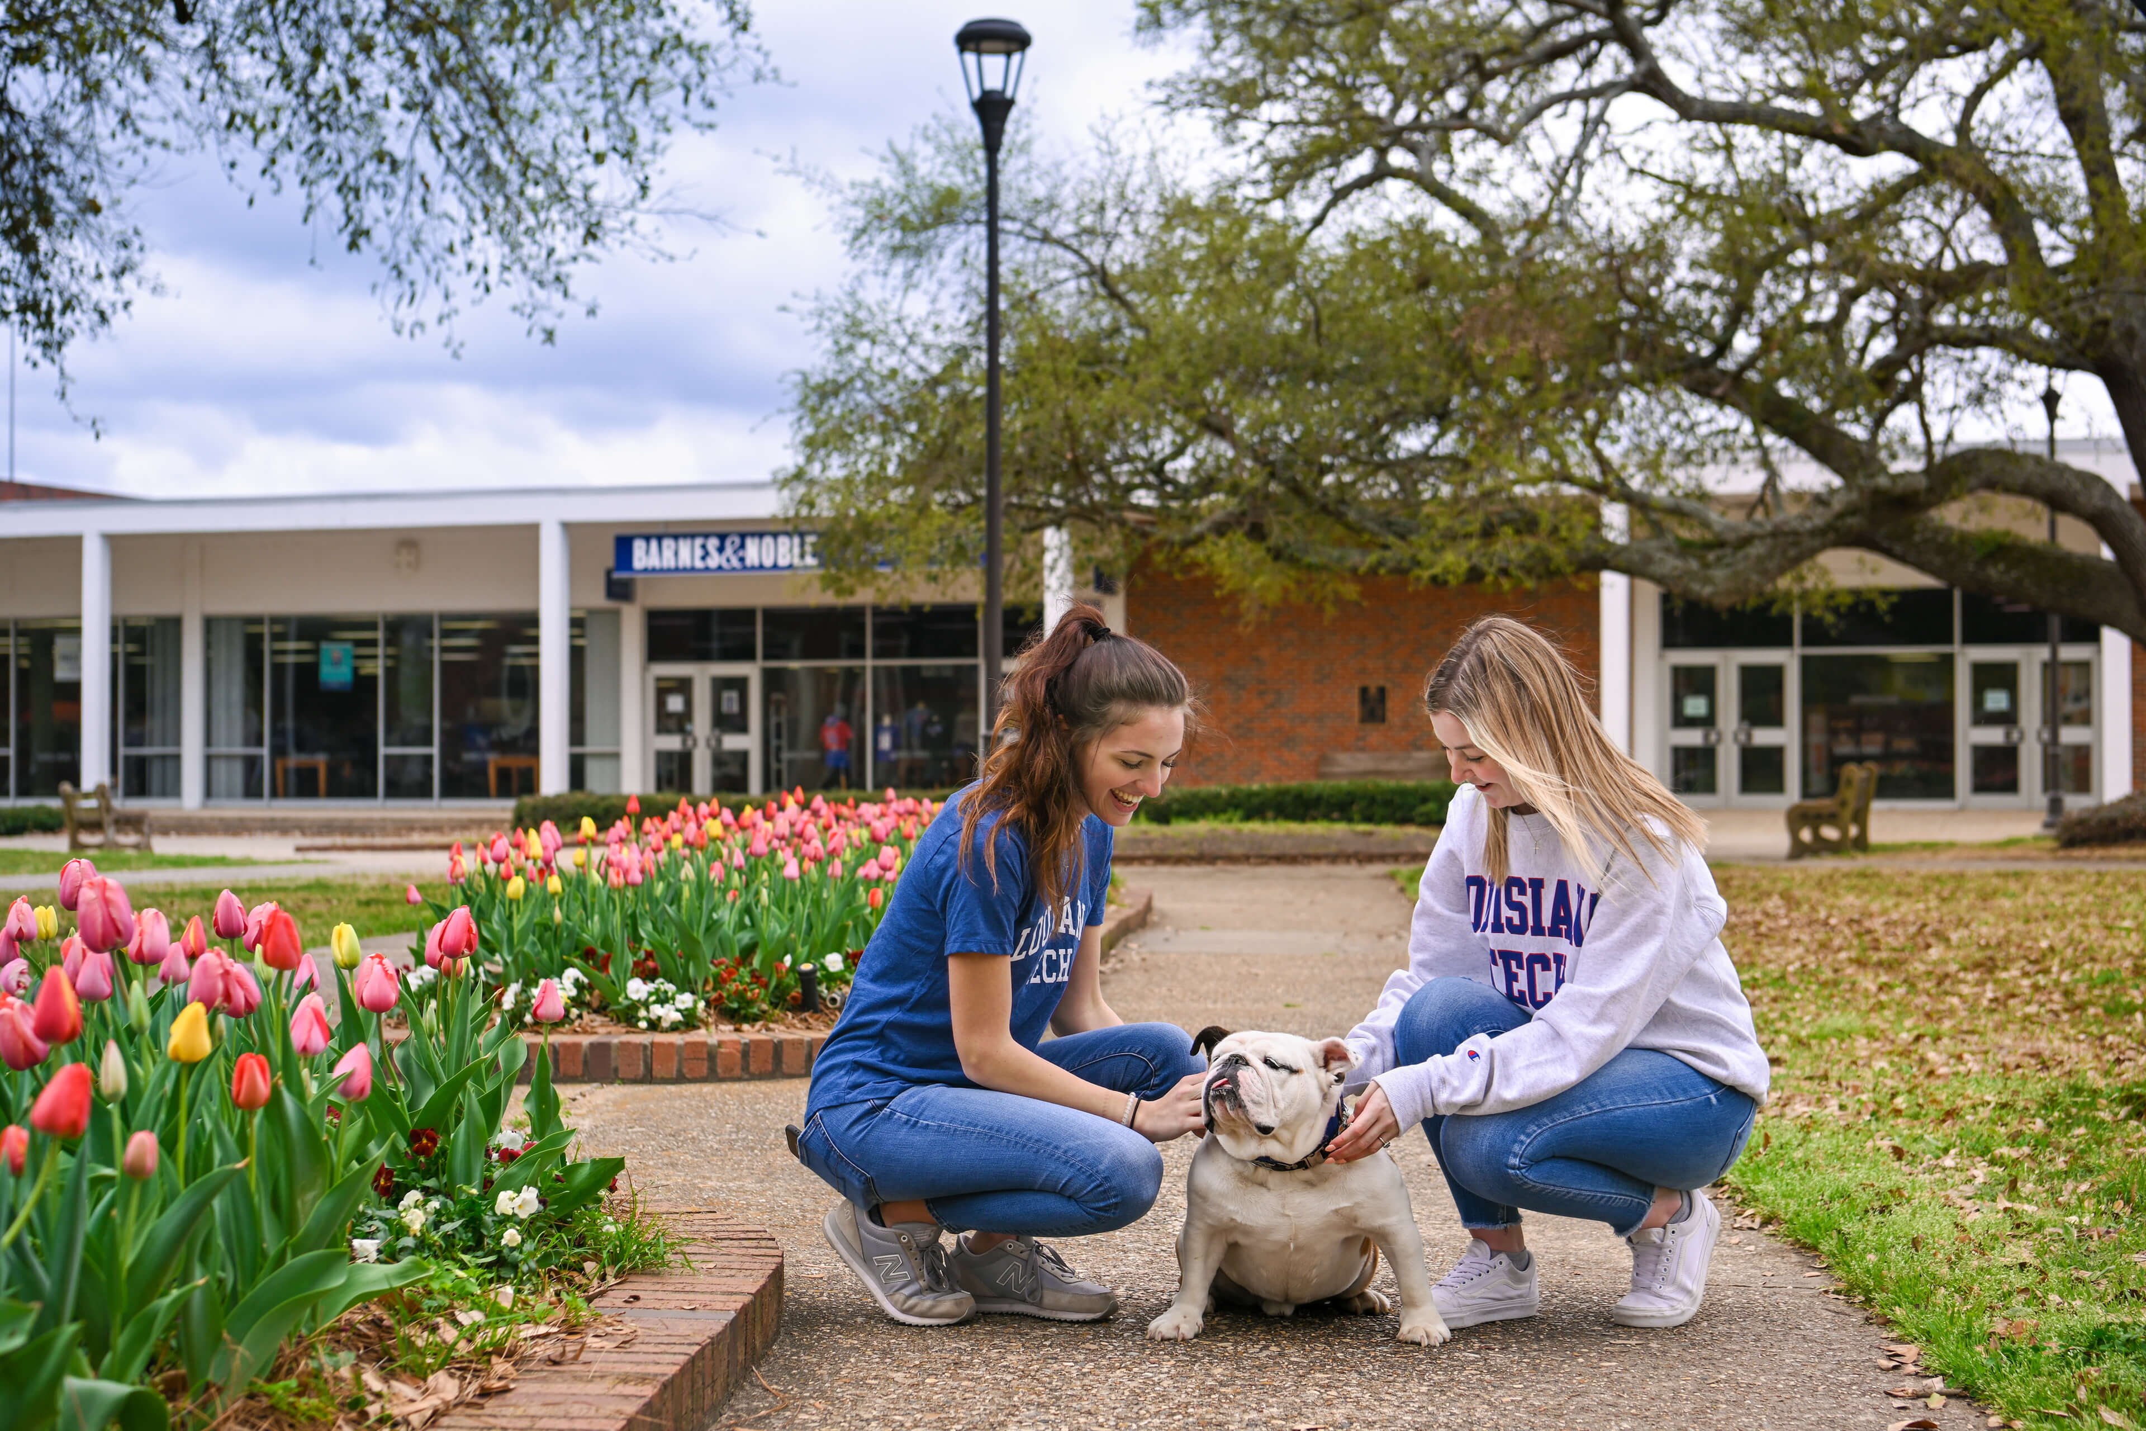
On-Campus Life
Student Involvement
From study groups to student organizations, there are many ways for international students to get involved at Louisiana Tech University. With over 180 student organizations, there is plenty to do. You can also improve your health and wellness at the Lambright Sports and Wellness Center on campus.
1
Available Resources for Students
BARC
Career Center
Counseling Services
Tech Care
Intramural Sports and Recreation and so on
2

Slide 8
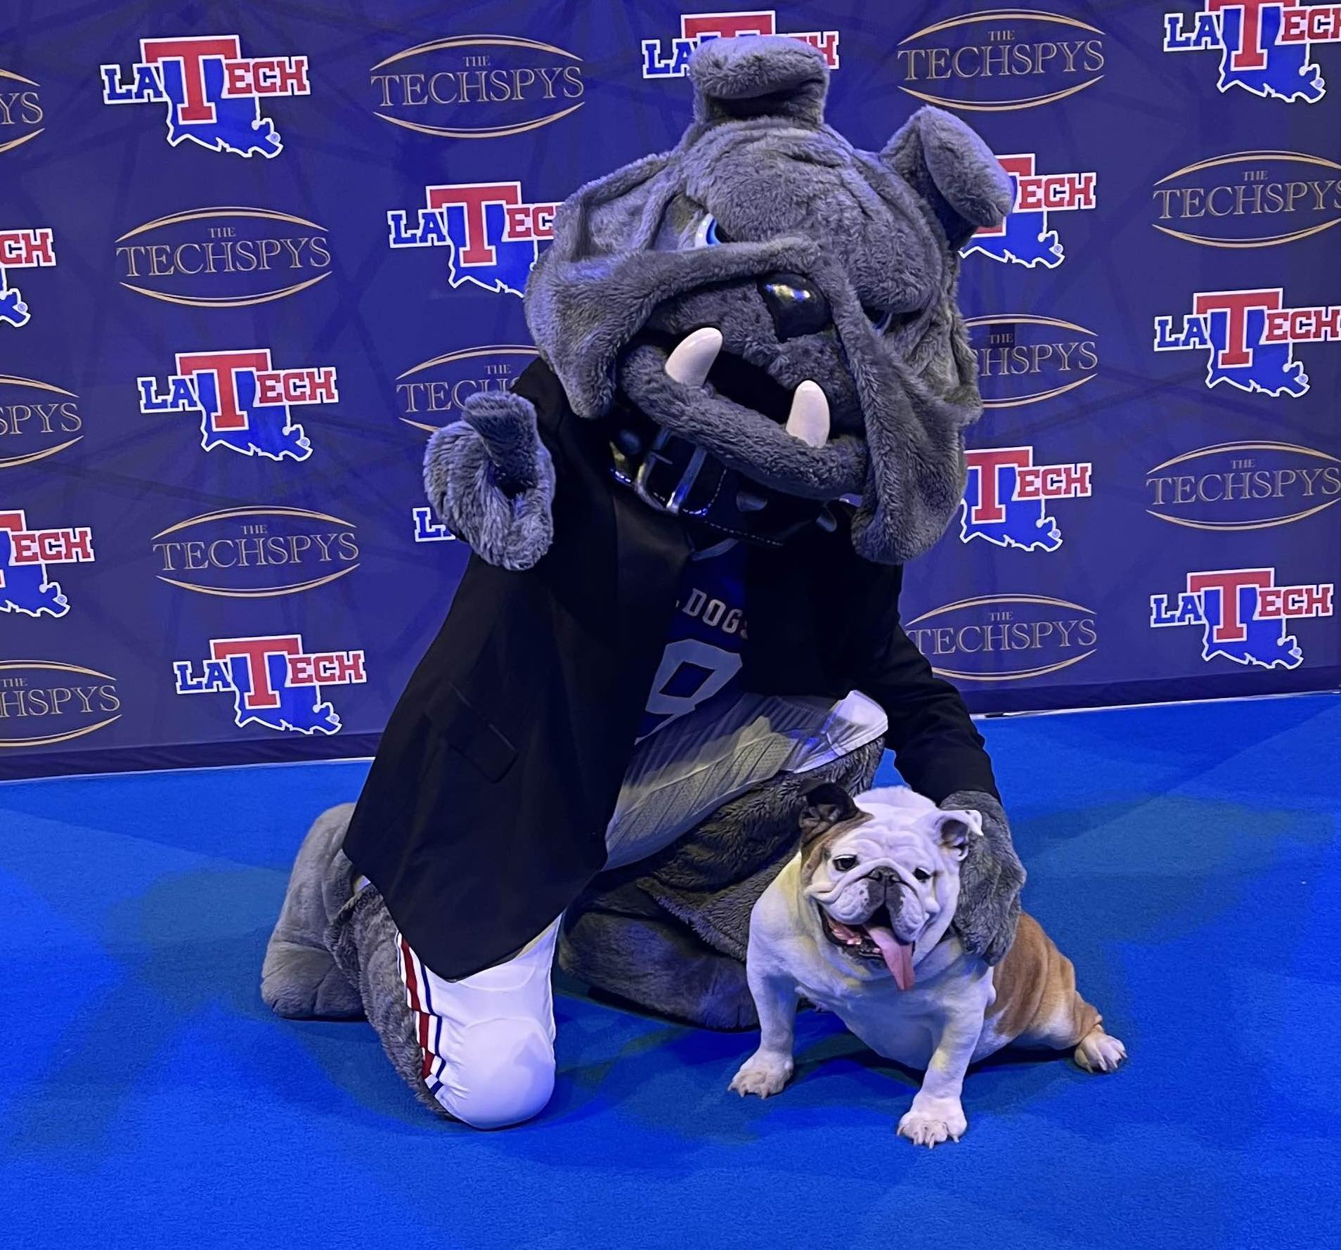
Thank You!
We appreciate your attendance and engagement in this informational session.
Housing Department Contact Info:
For further inquiries regarding housing, please reach out to: housing@latech.edu
Visit the housing portal for more info: https://www.latech.edu/student-life/housing-and-dining/housing/index.php

